Slide 1







LLA PURPLE SLIDES – HR USE
NOVEMBER 2025
Technical Challenge – Solutions Architect
(Customer Interactions Analytics with Gen AI on AWS)
Part of Liberty Latin America
Juan Esteban Mejía Velásquez

Slide 2




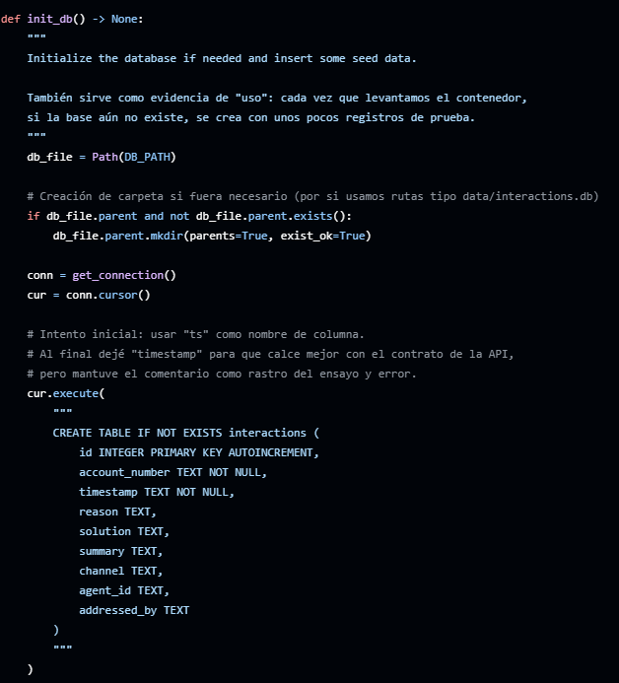









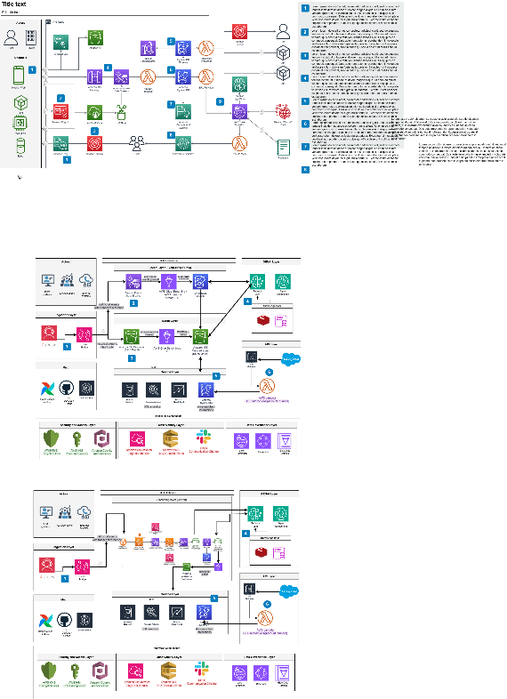

Content
LLA PURPLE SLIDES – HR USE
Context and Requirements
Data Architecture
Logical Data Model
Security, Observability and API Layer
(1) Homes Passed, Fixed RGUs, and Mobile subscribers are reported as of September 30, 2025. Revenue data for the nine months ended September 30, 2025, annualized.
5

Slide 3
Context and Requirements 1.1 System Objective
LLA PURPLE SLIDES – HR USE
The objective of the system is to provide an AWS-based platform that ingests Customer Care transcripts (voice and chat), processes them into normalized, structured interaction data, and enriches this data using Generative AI (GenAI).
Centralize transcripts from multiple contact center solutions.
Extract key fields such as intent, reason for contact, resolution, sentiment, product, and next best action using GenAI.
Make the enriched interaction history easily consumable by downstream systems (CRM, analytics, reporting, and operations tools).

Slide 4

1.2 Main Users / Actors 1.2.1 CRM Systems (Salesforce) What the platform provides to them
LLA PURPLE SLIDES – HR USE
Role CRM platforms are the main consumers of the enriched interaction history. They provide the 360° customer view used by sales, service, and marketing teams.
What the platform provides to them
A standardized interaction feed (API or batch export) with:
Transcript metadata (channel, date, agent, duration, etc.).
GenAI-derived attributes (intent, resolution status, sentiment, topics, product, effort, etc.).
Up-to-date timeline of customer interactions, enabling:
Better case management and follow-up actions.
Triggering workflows (create case if no resolution, start NPS survey, etc.).
Consistent identifiers (customer ID, account ID, contact ID) that allow CRM to link interactions to accounts, opportunities, and tickets.

Slide 5
LLA PURPLE SLIDES – HR USE
CRM Systems (Salesforce) Advance Analytics User Cases
Intelligent Case Prioritization and Routing
Scoring that classifies each case based on urgency, economic impact, and complexity, using AI-enhanced attributes.
Value: Improves SLAs and customer experience by assigning the most critical cases first and routing them to the most appropriate team.
Customer Health Score 360°
An index that summarizes customer health in a single number, combining product usage, recent tickets, sentiment, and previous interactions.
Value: Sales, Service, and Marketing in Salesforce have a clear signal to prioritize sales, preventative, or loyalty-focused actions.
Measuring the Impact of Campaigns and Operational Changes
Description: Models and analytics that compare contact patterns and sentiment before and after campaigns, policy changes, or product launches.
Value: Enables teams within Salesforce to see whether initiatives actually reduce contacts, improve satisfaction, or generate new opportunities.

Slide 6

1.2.2 CX / Operations Teams What the platform provides to them
LLA PURPLE SLIDES – HR USE
Role Customer Experience (CX) and Operations teams use the platform to understand why customers contact the company, how issues are resolved, and where to improve processes.
What the platform provides to them
Aggregated analytics on:
Volume by contact reason, channel, and product.
First contact resolution, transfer/escallation rates, and handle times.
Sentiment and customer effort across journeys.
Dashboards and self-service analysis (e.g. via Athena/Redshift + Quick Suit or similar), allowing them to:
Detect emerging issues and repetitive pain points.
Measure impact of operational changes or campaigns.
Prioritize training and process improvements.
Ad-hoc query capabilities over a curated data model so CX teams can explore interactions without depending on engineering for every question.

Slide 7
CX / Operations Teams Advance Analytics User Cases
LLA PURPLE SLIDES – HR USE
Anomaly Detection in Interactions and Operational Metrics
Anomalies in: volume, FCR, AHT, transfer, sentiment. Early warning when a new technical or billing issue "explodes" in the call center.
Value: React hours or days in advance to incidents affecting thousands of customers ansd reduce massive escalations and pressure on agents.
Service Quality Models and Agent Coaching
Automatic scoring of interactions based on script adherence, empathy, clarity, proper closure, resolution confirmation, etc. Agent ranking and identification of coaching needs.
Value: More objective and scalable QA (instead of listening to random samples). Specific training plans by agent, reason, or channel.
Impact Measurement of Operational Changes (Causal/Uplift Models)
Before/After comparison of: New scripts, IVR, bots, self-service flows. Policy changes (fees, discounts, installation times, etc.).
Value: Knowing which changes actually reduce volume, increase first-consumer ratio (FCR), or improve customer sentiment. Avoiding investment in initiatives that don't make a difference.
Next Best Action Recommenders for Customer Service
Models that suggest to the agent:
Next key question.
Most likely solution to work.
Most relevant knowledge base content.

Slide 8

External Systems Generating Transcripts What the platform provides to them
LLA PURPLE SLIDES – HR USE
Role These systems produce the raw call and chat transcripts that feed the platform.
What the platform provides to them
A simple, standardized ingestion interface (event streams, APIs, or file drop in S3) so that each provider does not need custom integration into every downstream system.
A common normalization layer that:
Maps different provider formats to a unified schema (customer, session, utterances, timestamps, agents).
Applies consistent PII handling, logging, and monitoring.
Feedback channels (optional) such as enriched events back to the contact platform, enabling:
Real-time agent assist signals.
Routing or prioritization based on GenAI-calculated attributes (urgency, sentiment).

Slide 9
Quality Attributes Analysis and Decision - Summary
LLA PURPLE SLIDES – HR USE
Quality attribute | Context & Requirements | Key architectural intention / decision
Scalability | Initial volume 100k interactions/day, 2–3x peaks, preference for serverless and auto-scaling services | Use serverless services (Lambda, DynamoDB, S3, Bedrock, EventBridge, Kinesis), good key and partition design to avoid hotspots
Performance / Latency | Batch with hours of latency; event-driven near real-time in seconds or a few minutes | Separate historical batch flow from event-driven flow; minimize prompt size and optimize calls to the LLM
Security and privacy (PII) | Transcripts with PII, mandatory encryption with KMS, TLS in transit, logs without PII | Encryption in S3, DynamoDB, Kinesis, SQS; least-privilege IAM; masking/redaction before logging; care about what is sent to the LLM
Cost efficiency | Prefer managed/serverless, use batch for historical data, optimize and limit calls to the LLM | Pay-per-use architecture; use batch when near real-time is not required; optimize prompts and evaluate caching of LLM responses
Data governance / organization | S3 as single entry point for raw data, DynamoDB as online store, ability to export to the data lake | “Raw in S3, enriched in DynamoDB” model; clear partitioning in S3; lineage from raw to API; periodic exports for analytics
Maintainability | New channels and platforms (Connect, Genesys, Five9), platform and ML teams that must evolve prompts and models | Modular pipelines per channel but converging on a common model; versioned prompts; separation between ingestion, enrichment and API exposure
API usability | History API by account_number with pagination and simple filters, integrated in the CRM (Salesforce, etc.) | Stable and simple API contract; clear pagination; basic filters; adequate documentation; hide internal storage details

Slide 10

Quality Attributes Scenerios
LLA PURPLE SLIDES – HR USE
These are just prototypical examples. This exercise should be done as a team. It improves everyone's involvement and the decision-making process. (In a complex system like a Data Arch, having different perspectives contributes more and better to understanding)

Slide 11
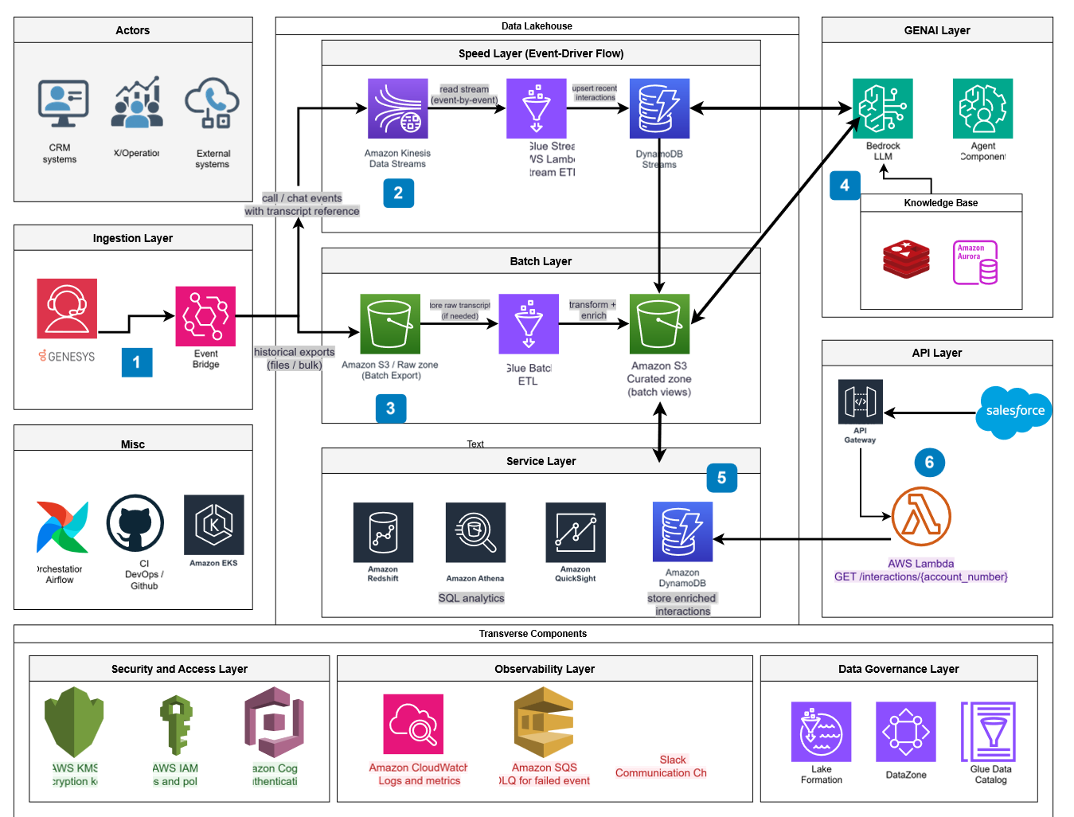
Data Architecture
First Iteration
LLA PURPLE SLIDES – HR USE
* Contact center to EventBridge
Calls/chats from Genesys (or similar) generate events with a transcript reference. All events go first to Amazon EventBridge, the single entry point.
* Real-time (speed) path
EventBridge sends events to **Kinesis Data Streams**. A streaming job (Glue Streaming / Lambda) enriches them and stores the latest interactions in **DynamoDB**, optimized for low-latency reads.
Batch (historical)
path In parallel, the contact center exports bulk interaction files to **S3 Raw**. Batch Glue jobs clean and enrich them, writing analytics-ready tables to **S3 Curated**, forming the full interaction history.
* GenAI layer A Bedrock LLM plus a knowledge base consumes both:
* Recent data from **DynamoDB Streams**
* Historical, curated data from **S3 Curated** and the KB
An orchestration/agent component builds prompts, calls the LLM, and adds extra lookups to generate reasons for contact, solutions, and summaries.
Service layer
The final enriched interaction records live in DynamoDB as the main operational store, also used by analytics tools (Redshift, Athena, Quick Suit) alongside S3 data.
API / CRM integration
An AWS Lambda behind API Gateway exposes an endpoint like `GET /interactions/{account_number}`, reading from DynamoDB (and optionally S3/GenAI) so systems like **Salesforce** can retrieve a customer’s full interaction history.

Slide 12
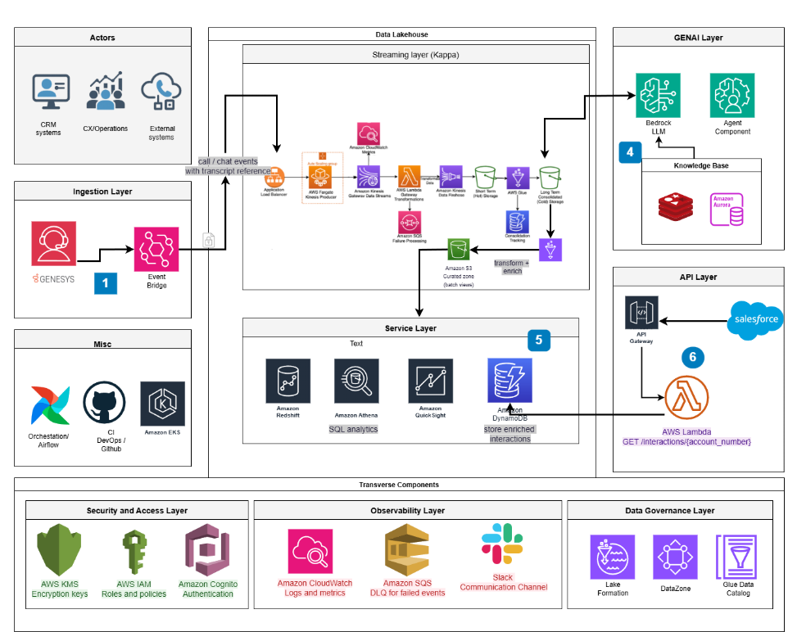
Switch Lambda Arch to Kappa
Second Iteration
LLA PURPLE SLIDES – HR USE
1. The workload is naturally event-driven
Calls and chats arrive as a continuous stream of interaction events and transcripts from Genesys . With Kappa you design one streaming pipeline that processes every event (real-time or historical) the same way.
2. One place to implement GenAI extraction
3. Easier reprocessing when the model or prompts change
4. Operational simplicity and lower maintenance
Kappa:
One data flow, one set of jobs, one monitoring surface.
Lambda:
Two different flows to monitor (batch + speed). Two sets of failure modes, two places to debug, two places to tune performance and cost.
For a small platform team, Kappa is usually cheaper to operate over time.

Slide 13
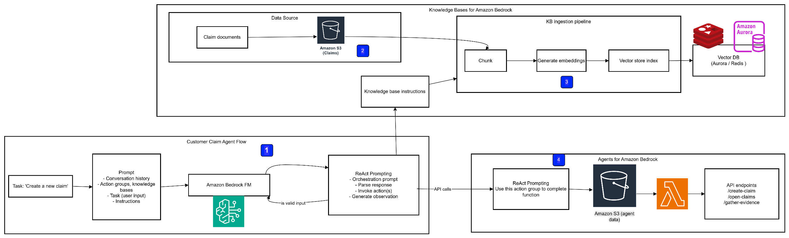
GenAI Layer
Deep Dive
LLA PURPLE SLIDES – HR USE

Slide 14
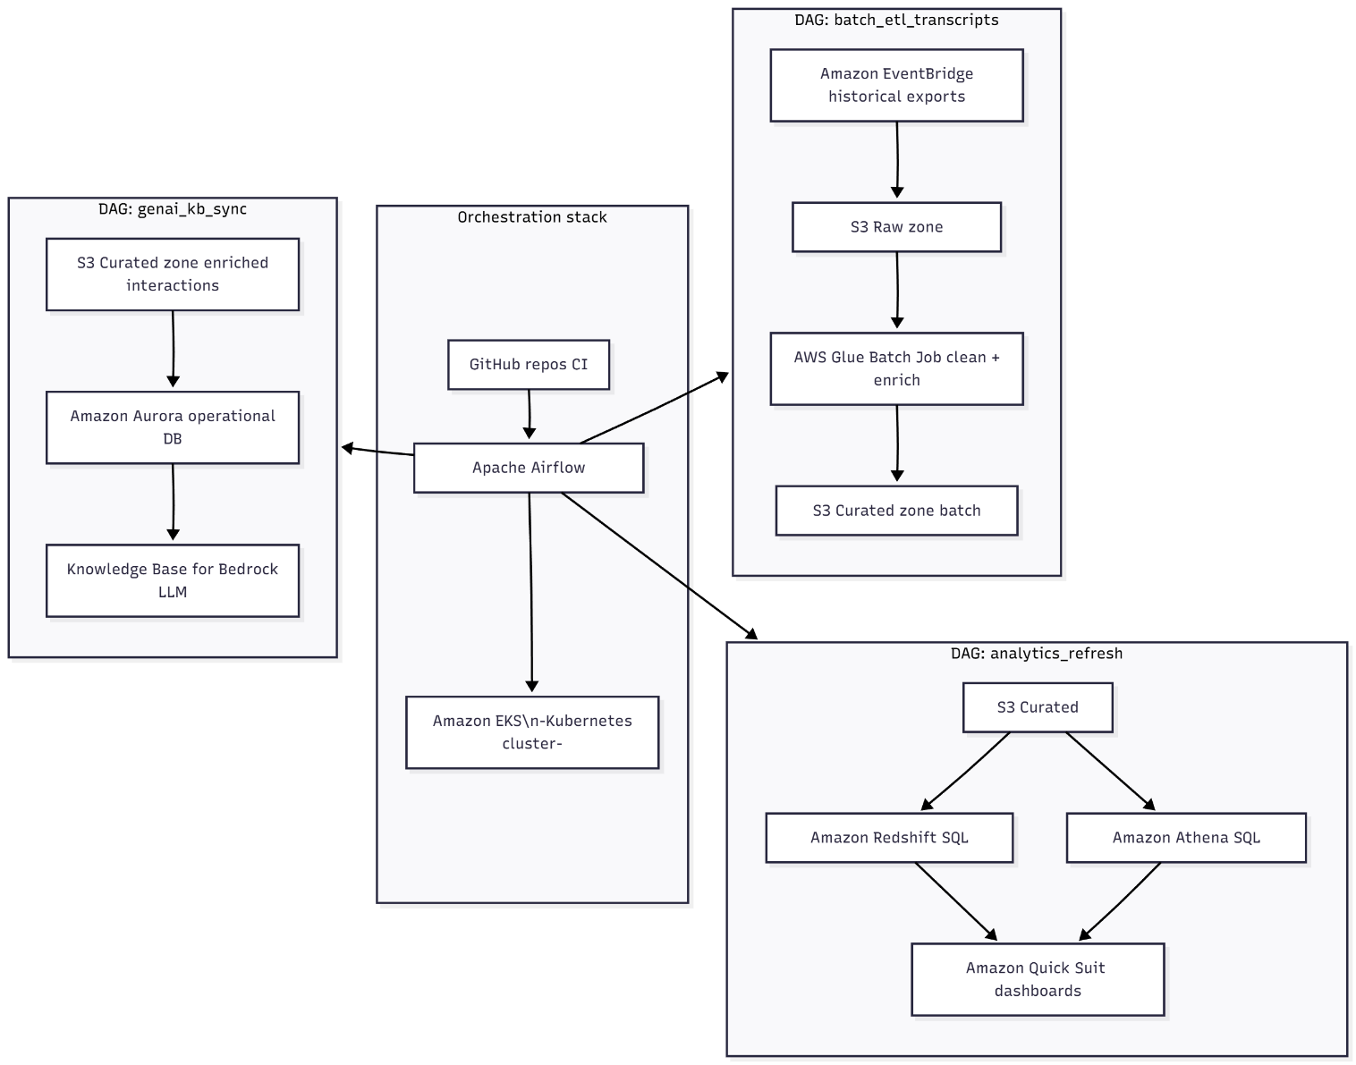
Orchestration Deep Dive
LLA PURPLE SLIDES – HR USE

Slide 15
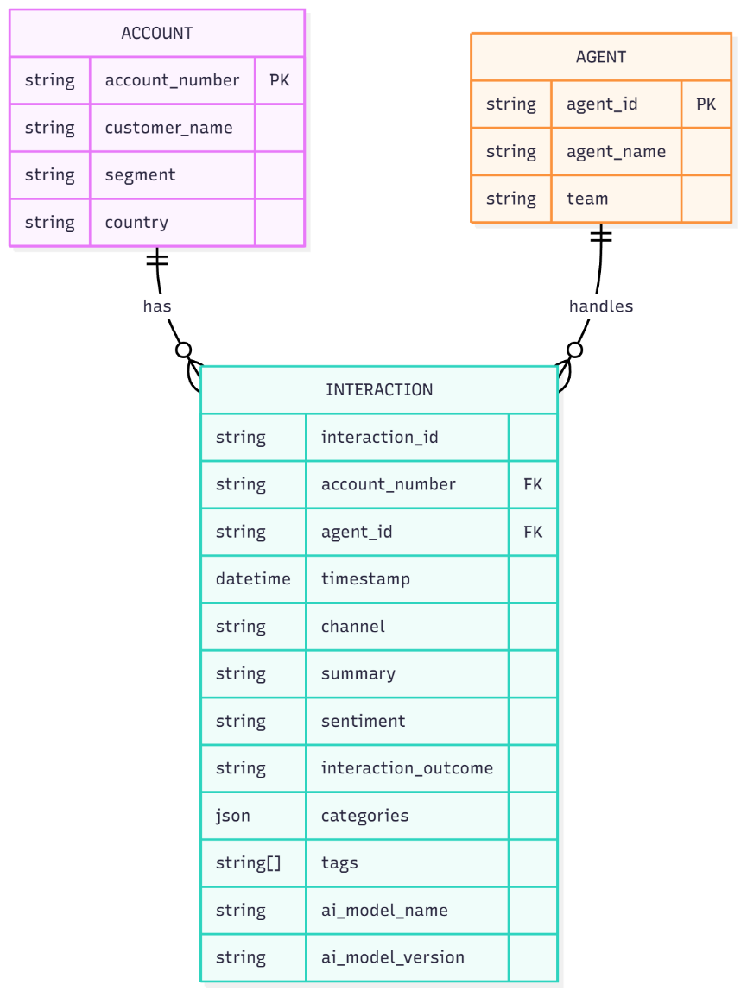
Data Logicial Model
LLA PURPLE SLIDES – HR USE
Core idea of ​​flexibility
Divide the logical model into two layers:
Stable attributes: Those that almost never change:
interaction_id, account_number, timestamp, channel, summary, sentiment, etc.
Dynamic categorization attributes:
Everything that generative AI detects as “business areas/sub-areas/topics/categories” is stored in generic, hierarchical structures, not in fixed columns.
2. New design for categories:
categories and tags
In the Interactions table (DynamoDB or Aurora), instead of:
call_reason_primary
call_reason_secondary
call_reason_tertiary
agent_solution_type
etc.

Slide 16

Data Logicial Model
LLA PURPLE SLIDES – HR USE
Attribute 1: categories (hierarchical and generic structure)
reason, solution, risk, product, topic, etc. are category namespaces.
path is the hierarchy: area, subarea, sub-subarea (as deep as the AI ​​requires).
code allows you to link to a taxonomy table if you want a more structured approach.
source: GEN_AI, HUMAN_TAG, RULE_ENGINE, etc.
confidence: very useful for filters and analysis.
"categories": {
"reason": [
{
"path": ["Billing", "Invoice", "Missing"],
"code": "BILL.INVOICE.MISSING",
"confidence": 0.94,
"source": "GEN_AI",
"level": 3
}
],
"solution": [
{
"path": ["Resend Document", "Email"],
"code": "SOL.DOC.RESEND_EMAIL",
"confidence": 0.90,
"source": "GEN_AI",
"level": 2
}
],
"risk": [
{
"path": ["ChurnRisk", "Medium"],
"code": "RISK.CHURN.MEDIUM",
"confidence": 0.77,
"source": "GEN_AI"
}
]
}

Slide 17
Data Logicial Model
LLA PURPLE SLIDES – HR USE
Attribute 2: Tags (flat list for quick search)
Useful for:
simple searches,
quick filters in reporting,
feature engineering in ML models.
5. Practical Advantage of this Design
If tomorrow AI starts detecting new things like:
categories.product,
categories.complaint_type,
categories.ltv_segment, you don't have to add new columns: just new namespaces and new paths within categories.
You can continue deriving "classic" KPIs (churn_risk_level) from the categories, but the physical model doesn't break when you change taxonomies.
"tags": [
"reason:billing",
"reason:invoice_missing",
"solution:email_resend",
"risk:churn_medium",
"topic:payment_methods"
]

Slide 18

Data Logicial Model
LLA PURPLE SLIDES – HR USE
Practical advantage of this design If tomorrow AI starts detecting new things like:
categories.product,
categories.complaint_type,
categories.ltv_segment, You don't need to add new columns: just new namespaces and new paths within
categories.
You can continue to derive "classic" KPIs (e.g., churn_risk_level) from the categories, but the physical model does not break when you change taxonomies.

Slide 19
Contracts
API Contract and Data Contract
LLA PURPLE SLIDES – HR USE
Data Contract – Open Data Contract
API Contract – OpenAPI V3
https://github.com/JEstebanMejiaV/customer-interactions-analytics-genai-solutions-architect/blob/main/contracts/data_contract.ylm
https://github.com/JEstebanMejiaV/customer-interactions-analytics-genai-solutions-architect/blob/main/contracts/interaction_api.ylm
What are the benefits of adding an Open Data Contract?
For Salesforce and other consumers: They can see in one place which fields exist, what they mean, what PII is, and what the SLA is for the interaction history.
CX/Operations: It's clear what they can expect from the dataset (latency, retention, minimum quality), and which fields to use for analyzing motives, solutions, sentiment, etc.
Data Platform and Data Engineering: They have a versionable contract in Git that connects:
physical servers (DynamoDB/S3),
logical schema (Interactions),
quality rules,
SLAs, and permissions.

Slide 20
Security, Observability and data Governance Layers
Q & A
LLA PURPLE SLIDES – HR USE
How are internal services authenticated and authorized?
They rely on IAM roles for each Lambda, Glue job and data store, but the design still needs clearer environment separation and network boundaries to make least-privilege really effective.
How are external consumers authenticated and authorized?
External systems and users go through API Gateway using API Keys or Cognito/JWTs, yet the model is still vague about tenant isolation and fine-grained permissions beyond generic “agent” and “admin” roles.
How is access separated between agents, administrators and background jobs?
Conceptually each group has different scopes (read-only, management, technical jobs), but there is no explicit mapping from those business roles to concrete IAM and database permissions.
How is sensitive data protected at rest?
All storage is expected to use KMS encryption, although the design does not specify key rotation, distinct keys per zone, or who is allowed to decrypt which datasets.
How is sensitive data protected in transit and before it reaches the LLM?
Traffic should use TLS and transcripts should be masked before calling Bedrock, but the pipeline is missing precise PII-detection rules and guarantees that sensitive fields never leak into logs or traces.
How do we observe and trace the flow from S3 through Lambda and the LLM to the database?
CloudWatch logs, metrics and tracing are planned, yet the architecture does not enforce a common correlation id or define SLIs/SLOs, so true end-to-end visibility is not fully assured.
How do we detect and handle failure
s in the streaming pipeline? Failed events are routed to an SQS dead-letter queue with retries and alerts, but the strategy does not distinguish transient issues from permanent “poison” messages or describe clear remediation rules.
How do we reprocess interactions that could not be enriched initially?
Batch jobs can replay events from DLQs or S3 to attempt enrichment again, although the design still lacks limits on retries, controls against duplicates and an audit trail for irrecoverable records.

Slide 21
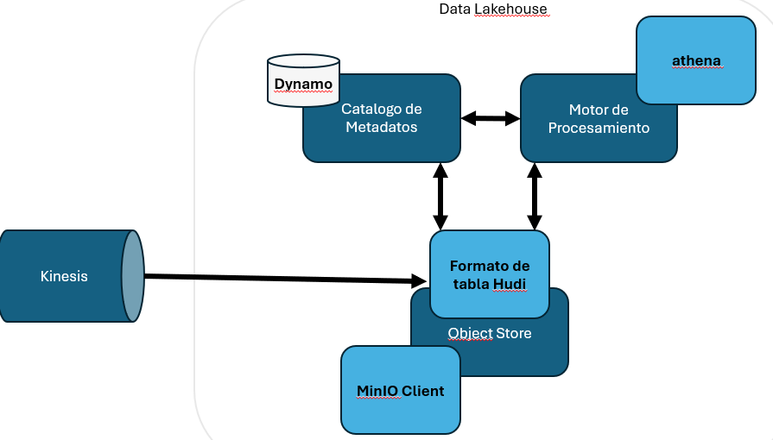
Data Lakehouse
^{Summary}
LLA PURPLE SLIDES – HR USE
Tema del challenge | Cómo aporta Hudi en ABCD
+100.000 interacciones/día y crecimiento | Hudi evita tener millones de archivos pequeños en S3 y mantiene un timeline de commits que registra cada batch o micro-batch.
Reprocesos cuando cambia el modelo de IA | Cuando se cambia el prompt o el modelo de Gen AI, Hudi permite:Leer incrementalmente las interacciones que no se enriquecieron o que tienen una versión vieja. Escribir nuevas versiones manteniendo historiales, si lo deseas. Auditar qué commit corresponde a qué versión del modelo.
Soporte a PII y cumplimiento | Cada commit de Hudi tiene metadatos de quién escribió, cuándo, desde qué job. Si los cruzas con los logs de CloudWatch (Lambda, Glue), tienes una trazabilidad clara
Soporte a PII y cumplimiento | Si necesitas borrar o anonimizar datos de un cliente puedes hacer updates/deletes a nivel de fila en Hudi y luego compactar. Gracias al timeline, puedes demostrar cuándo se aplicó el borrado o la anonimización. Esto se complementa con Lake Formation, que sigue controlando quién puede consultar Raw/Curated.

Slide 22
Next Steps
^{Summary}
LLA PURPLE SLIDES – HR USE
Area | What the architecture assumes is solved | The question that’s still open
Internal identity (IAM) | All internal services use IAM roles with least privilege (Lambda, Glue, Kinesis, S3, DynamoDB, Redshift, Bedrock). | How are environments and tenants separated at the network level (VPCs, subnets, endpoints), not just with generic IAM policies?
External access and roles | API Gateway fronts all external access; API Keys for system integrations and Cognito/JWT for agents and admins. | Where is the explicit mapping from agent / supervisor / admin / background job to concrete permissions on APIs, tables and columns?
LLM usage (Bedrock) | The LLM enriches interactions based on transcripts flowing through the pipeline. | What data-usage guarantees do we require (no training, retention limits), and how do we ensure we only send the minimum necessary text to the LLM?
End-to-end observability | CloudWatch centralizes logs and metrics; traces exist for S3 – Lambda – LLM – database; SQS DLQ captures failed events. | What is the mandatory correlation_id, what are the reference SLIs/SLOs, and which alerts actually trigger a human response?
Errors and reprocessing | Failed messages go to a DLQ and there are batch jobs to try enrichment again. | How many retries are allowed, how are “poison messages” handled, how do we avoid duplicates, and what is the audit trail for discarded records?
Retention and compliance | The data lake keeps history and exposes it to analytics and CX. | What is the retention matrix per dataset, how is “right to be forgotten” implemented, and how do we handle regulatory differences by country/business?

Slide 23

Part of Liberty Latin America

Slide 24
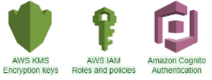



Security, Observability and data Governance Layers
Brief Descriptions
LLA PURPLE SLIDES – HR USE
Security Components
Observability Components
Data Governance Components
Tema | Puntos clave
Etiquetado con LF-Tags | - Definición de etiquetas como sensitivity = PII y sensitivity = NON_PII - PII: Entre otras
Permisos basados en etiquetas | - Grupo cx_analyst: SELECT solo sobre columnas NON_PII - Grupo compliance: acceso también a columnas PII para investigaciones
Column/row level security | Bloquear acceso a transcript_text y exponer solo summary generada por IA - Filtros por país, región, unidad de negocio, para que cada equipo vea solo sus clientes
Cifrado complementario | El cifrado en reposo y en tránsito se hace con KMS y TLS
Enmascaramiento | Posibilidad de vistas SQL con datos enmascarados (cuentas truncadas, etc.)
Tema
Auditoría de accesos | - Operaciones de GRANT/REVOKE y accesos a datos gobernados quedan registrados en CloudTrail y CloudWatch Logs - Permite responder: quién consultó datos de un país, quién consultó columnas PII, etc.
Trazabilidad con pipelines | Se pueden cruzar: - Logs de ejecución de Glue Jobs y Lambda en CloudWatch - Logs de acceso a datos de Lake Formation y S3 - Ante un fallo o incidente, se identifica: qué job tocó qué tablas y qué usuarios consultaron esos datos después
Reprocesos controlados | -En reprocesos batch de interacciones no enriquecidas desde S3 Curated
Tema | Puntos clave
Dónde se ubica | -Capa de datos sobre S3 Raw/Curated y Glue Data Catalog - Controla acceso de servicios de consumo (Athena, Redshift, Glue Jobs, EMR, etc.)
Control centralizado de permisos | - No se dan permisos directos a S3 por rol IAM - En Lake Formation se define qué BD/tablas puede consultar cada rol - Soporta permisos por columna y filtros por fila
Ejemplos de roles | - cx_analyst: solo lee vistas curadas sin campos sensibles - data_engineer: puede leer Raw y Curated para depurar y reentrenar modelos
Integración con identidades | - Usuarios finales (agentes, analistas) se autentican con Cognito o SSO - Su identidad se mapea a grupos/roles IAM y Lake Formation aplica las políticas de acceso a datos

